Slide 1

Noida Institute of Engineering and Technology, Greater Noida
Mobile Application Development
ACSIOT0401
Unit: II
Android Developing Environment
Vatika Jalali
Assistant Professor
IoT Department
4th Semester
(IoT)

Slide 2







Faculty Profile
Responsibilities
Faculty IoT,
Mentor IoT
Research Interests
Digital Image processing,
Machine Learning
Ms. Vatika Jalali
Assistant Professor, IoT
Education
M.Tech CSE, PTU
B.Tech CSE, HPTU
Publications
Research Paper: 4
Work Exp.
NIET, Gr. Noida (September, 2022 to till date)
Worked at Chandigarh University
Ms. Vatika Jalali Mobile Application Development Unit-2

Slide 3
Evaluation Scheme
Sl. No. | Subject Codes | Subject Name | Periods |  |  | Evaluation Scheme |  |  |  | End Semester |  | Total | Credit
 |  |  | L | T | P | CT | TA | TOTAL | PS | TE | PE
1 | AAS0402 | Engineering Mathematics- IV | 3 | 1 | 0 | 30 | 20 | 50 |  | 100 |  | 150 | 4
2 | AASL0401 | Technical Communication | 2 | 1 | 0 | 30 | 20 | 50 |  | 100 |  | 150 | 3
3 | ACSE0403B | Operating Systems | 3 | 0 | 0 | 30 | 20 | 50 |  | 100 |  | 150 | 3
4 | ACSAI0402 | Database Management Systems | 3 | 1 | 0 | 30 | 20 | 50 |  | 100 |  | 150 | 4
5 | ACSIOT0401 | Mobile Application Development | 3 | 0 | 0 | 30 | 20 | 50 |  | 100 |  | 150 | 3
6 | ACSE0404 | Theory of Automata and Formal Languages | 3 | 0 | 0 | 30 | 20 | 50 |  | 100 |  | 150 | 3
7 | ACSE0453B | Operating Systems Lab | 0 | 0 | 2 |  |  |  | 25 |  | 25 | 50 | 1
8 | ACSAI0452 | Database Management Systems Lab | 0 | 0 | 2 |  |  |  | 25 |  | 25 | 50 | 1
9 | ACSIOT0451 | Mobile Application Development Lab | 0 | 0 | 2 |  |  |  | 25 |  | 25 | 50 | 1
10 | ACSE0459 | Mini Project using Open Technology | 0 | 0 | 2 |  |  |  | 50 |  |  | 50 | 1
11 | ANC0402 / ANC0401 | Environmental Science*/ Cyber Security*(Non Credit) | 2 | 0 | 0 | 30 | 20 | 50 |  | 50 |  | 100 | 0
 |  | MOOCs** (For B.Tech. Hons. Degree)
 |  | GRAND TOTAL |  |  |  |  |  |  |  |  |  | 1100 | 24

Slide 4
Syllabus
Course Contents / Syllabus
UNIT-I | Introduction to Mobile Application and Architecture | 8 Hours
Mobile applications, History of mobile application frameworks, Characteristics and types of mobile applications, Achieving quality constraints. Mobile Architecture- Mobile Hardware Architecture: processors used for Mobile and Handheld devices and SoC architecture; Mobile Software Architecture: Real Time Operating systems and Mobile Real Time Operating Systems, SDK’s.
UNIT-II | Android Developing Environment | 6 Hours
Introduction to Android, Android ecosystem, Android SDK and Installation, Layered Architecture of Android, Android API levels (versions & version names), Android Development Tools, Basic Building blocks – Protocols, Activities, Services, Broadcast Receivers & Content providers.
UNIT-III | UI Components and Multimedia | 10 Hours
Fundamental UI design, layout and view types, Interaction with server-side applications – Using Google Maps, GPS and Wi-Fi, Integration with social media applications, Interfacing sensor data with mobile application, Accessing applications hosted in a cloud computing environment. Multimedia Supported audio and video formats, Audio capture, Bluetooth, Animation.

Slide 5
Syllabus
UNIT-IV | Android Application Deployment | 8 Hours
Persisting data using SQLite database, Testing and debugging Android Application, Packaging and Android Application Deployment on device with Windows, Android Permissions. Testing and publishing of Mobile Applications on different app stores.
UNIT-V | iOS and Swift | 8 Hours
Introduction to Objective C, iOS features, UI implementation, Touch frameworks, Data persistence using Core Data and SQLite, Location aware applications using Core Location and Map Kit, integrating calendar and address book with social media application, using Wifi - iPhone marketplace. Swift: Introduction to Swift, Features of swift.

Slide 6
Branch wise Applications
A mobile app is a medium between an IoT device and a mobile phone.
The app works as the primary interface through which we can manage smart things.
Mobile IoT apps supplement and enhance the use of IoT to make it work more efficiently.

Slide 7
Course Objective
This course introduces students to programming technologies, design and development related to mobile applications using android/ iOS.
Course also aims at mobile application development frameworks; mobile architecture, design and engineering issues, techniques, methodologies for mobile application development.

Slide 8


Course Outcomes
Course outcomes : After completion of this course students will be able to
CO 1 | Recall vision, definition, conceptual framework, architecture of mobile applications. | K1
CO 2 | Describe and configure android development environment, tools, and architecture. | K2
CO 3 | Create and implement UI components and multimedia framework, fragments, audio capture, animation, and other activities. | K6
CO 4 | Integrate and interact with server-side applications with testing and deployment of android application. | K3
CO 5 | Analyze iOS and swift features, frameworks, map kit, and social media applications. | K4

Slide 9
CO-PO Mapping
Mapping of Course Outcomes and Program Outcomes:
CO.k | PO1 | PO2 | PO3 | PO4 | PO5 | PO6 | PO7 | PO8 | PO9 | PO10 | PO11 | PO12
ACSIOT0401.1 | 3 | 3 | 1 | 3 | 2 | 1 | 1 | 3 | 1 | 2 | 2 | 2
ACSIOT0401.2 | 3 | 3 | 2 | 3 | 3 | 2 | 3 | 3 | 2 | 2 | 3 | 2
ACSIOT0401.3 | 3 | 3 | 2 | 3 | 3 | 3 | 3 | 3 | 2 | 2 | 3 | 3
ACSIOT0401.4 | 3 | 3 | 2 | 3 | 2 | 1 | 1 | 3 | 1 | 1 | 2 | 2
ACSIOT0401.5 | 3 | 3 | 2 | 3 | 3 | 2 | 3 | 3 | 2 | 2 | 3 | 2
Average | 3 | 3 | 1.8 | 3 | 2.6 | 1.8 | 2.4 | 3 | 1.8 | 1.8 | 2.6 | 2.2
3= High, 2=Medium, 1=Low

Slide 10
Result Analysis
Subject | No. of students | Min Marks | Max Marks | Over all Result
Mobile Application Development | 40 | 30 | 80 | 95%

Slide 11
Ge
End Semester Question paper Templates
General Instructions:
All questions are compulsory. Answers should be brief and to the point.
This Question paper consists of …………pages & …8………questions.
It comprises of three Sections, A, B, and C. You are to attempt all the sections.
Section A -Question No- 1 is objective type questions carrying 1 mark each, Question No- 2 is very short
answer type carrying 2 mark each. You are expected to answer them as directed.
Section B - Question No-3 is Long answer type -I questions with external choice carrying 6 marks each.
You need to attempt any five out of seven questions given.
Section C - Question No. 4-8 are Long answer type –II (within unit choice) questions carrying 10 marks
each. You need to attempt any one part a or b.
Students are instructed to cross the blank sheets before handing over the answer sheet to the invigilator.
No sheet should be left blank. Any written material after a blank sheet will not be evaluated/checked.

Slide 12
 |  | SECTION – A |  | CO
 | Attempt all parts- |  | [10×1=10]
 | 1-a. | Question- | (1)
 | 1-b. | Question- | (1)
 | 1-c. | Question- | (1)
 | 1-d. | Question- | (1)
 | 1-e. | Question- | (1)
 | 1-f. | Question- | (1)
 | 1-g. | Question- | (1)
 | 1-h. | Question- | (1)
 | 1-i. | Question- | (1)
 | 1-j. | Question- | (1)
2. | Attempt all parts- |  | [5×2=10] | CO
 | 2-a. | Question- | (2)
 | 2-b. | Question- | (2)
 | 2-c. | Question- | (2)
 | 2-d. | Question- | (2)
 | 2-e. | Question- | (2)

Slide 13
SECTION – B |  |  |  | CO
3. | Answer any five of the following- |  | [5×6=30]
 | 3-a. | Question- | (6)
 | 3-b. | Question- | (6)
 | 3-c. | Question- | (6)
 | 3-d. | Question- | (6)
 | 3-e. | Question- | (6)
 | 3-f. | Question- | (6)
 | 3-g. | Question- | (6)
SECTION – C |  |  |  | CO
4 | Answer any one of the following- |  | [5×10=50]
 | 4-a. | Question- | (10)
 | 4-b. | Question- | (10)
5. | Answer any one of the following-
 | 5-a. | Question- | (10)
 | 5-b. | Question- | (10)
6. | Answer any one of the following-
 | 6-a. | Question- | (10)
 | 6-b. | Question- | (10)
7. | Answer any one of the following-
 | 7-a. | Question- | (10)
 | 7-b. | Question- | (10)
8. | Answer any one of the following-
 | 8-a. | Question- | (10)
 | 8-b. | Question- | (10)

Slide 14
Prerequisites
Overview of programming language
JAVA and XML.

Slide 15
Brief Introduction about the Subject with videos
Mobile application development is the process of creating software applications that run on a mobile device, and a typical mobile application utilizes a network connection to work with remote computing resources.
Hence, the mobile development process involves creating installable software bundles (code, binaries, assets, etc.) , implementing backend services such as data access with an API, and testing the application on target devices.
https://www.youtube.com/watch?v=bOiCw-ZZlGA
https://www.youtube.com/watch?v=09TeUXjzpKs&t=5270s

Slide 16
Recap of unit 1
Discussed about key concepts of mobile app development.
The opportunities and challenges of mobile apps.
The details of PC based apps as well as web based apps.
Content and key protocols of mobile apps
Evolution of mobile apps
Understand the software and hardware architecture

Slide 17
Unit Contents
Introduction to Android
Android ecosystem
Android SDK and Installation
Layered Architecture of Android
Android API levels (versions & version names)
Android Development Tools
Basic Building blocks – Protocols
Activities
Services
Broadcast Receivers
Content providers.

Slide 18
Unit Objective
To understand key concepts of android
To know the features and android platform
To know about the android SDK and architecture
To understand the installation of Android and using the basics
To understand the Activities, Services, Broadcast Receivers & Content providers.

Slide 19

Introduction to Android
Topic objective: To understand about the android and history
Android is a mobile operating system that is based on a modified version of Unix Like ( modified Linux kernel)
It was originally developed by a startup of the same name, Android, Inc.
In 2005, as part of its strategy to enter the mobile space, Google purchased Android and took over its development work.
The latest version of Android OS is 12, released in October 2021.
Android 13 (Tiramisu) released March 17, 2022.
Written in java, c, c++, others.
Notes:
Android , started in 2003, part of american technology company android inc. to develop an os for digital camera. Then an os for smart phones and google by 2005.

Slide 20
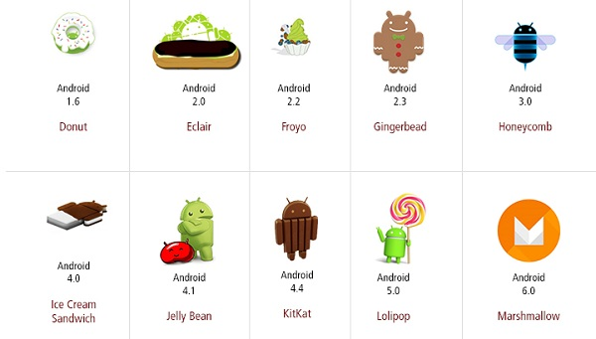
Android History

Slide 21
Android History
Code name | Version numbers | API level | Release date
No codename | 1.0 | 1 | September 23, 2008
No codename | 1.1 | 2 | February 9, 2009
Cupcake | 1.5 | 3 | April 27, 2009
Donut | 1.6 | 4 | September 15, 2009
Eclair | 2.0 - 2.1 | 5 - 7 | October 26, 2009
Froyo | 2.2 - 2.2.3 | 8 | May 20, 2010
Gingerbread | 2.3 - 2.3.7 | 9 - 10 | December 6, 2010
Honeycomb | 3.0 - 3.2.6 | 11 - 13 | February 22, 2011
Ice Cream Sandwich | 4.0 - 4.0.4 | 14 - 15 | October 18, 2011
Jelly Bean | 4.1 - 4.3.1 | 16 - 18 | July 9, 2012
KitKat | 4.4 - 4.4.4 | 19 - 20 | October 31, 2013
Lollipop | 5.0 - 5.1.1 | 21- 22 | November 12, 2014
Marshmallow | 6.0 - 6.0.1 | 23 | October 5, 2015
Nougat | 7.0 | 24 | August 22, 2016
Nougat | 7.1.0 - 7.1.2 | 25 | October 4, 2016
Oreo | 8.0 | 26 | August 21, 2017
Oreo | 8.1 | 27 | December 5, 2017
Pie | 9.0 | 28 | August 6, 2018
Android 10 | 10.0 | 29 | September 3, 2019
Android 11 | 11 | 30 | September 8, 2020
Android 12 | 12 | 31,32 | October 4,2021
Android 13 | 13 | 33 | August 15, 2022
Notes:
API level is an integer value that uniquely identifies the framework. API revision offered by a version of android platform. Api provides framework that interacts with android system. API consists of set of packages n classes.

Slide 22
Android History
Name | Internal Name | Version Number
Android 10 | Quince Tart | 10
Android 11 | Red Velvet Cake | 11
Android 12 | Snow Cone | 12
An application programming interface (API) is a connection between computers or between computer programs.
An API is often made up of different parts which act as tools or services that are available to the programmer.
A program or a programmer that uses one of these parts is said to call that portion of the API.

Slide 23
DAILY QUIZ 1
Name the latest version of android
When was the first version of android released.
Under which of the following Android is licensed?
OSS
Sourceforge
Apache/MIT
None of the above
4. Android is -
an operating system
a web browser
a web server
None of the above

Slide 24
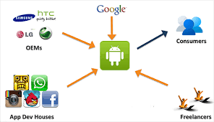
Android Ecosystem
Topic objective: To understand about the android ecosystem and the important blocks.
Notes:
Oems ..original equipment manufacturers

Slide 25
Android ecosystem
Android ecosystem is nothing but the relationship between Users, Developers/Programmers, and Hardware equipment makers, the Android ecosystem is nothing but the mutual dependence between Users, Developers, and equipment makers.
They are independent of each other so one cannot exist without the other.
The main block of the android ecosystem is:
Android User
Developer
Equipment Maker

Slide 26
Android ecosystem
Android User (Users buy handsets and software Application):
Android users have more space for customizability for their android devices.
Android users are smarter than other users and they are perceived to have greater levels of support.
Android users are also more likely to prefer saving their cost and love the openness of the platform also they like to customize their device.
Android users are fancier to prefer saving money and also android user like customizing their android handset/device

Slide 27
Android ecosystem
Developers (sell Application):
Android Developers are the professional software developer in designing applications as well as developing applications for Android.
Some of the following tasks where an android developer can play his role in the development of android apps:
Design and build advanced applications for the android platform
Collaborate and define with development teams for design and deliver new cool features.
Troubleshoot and fix bugs in new and existing applications for Users.
Evaluate and implement new development tools to work with outside data sources and APIs.

Slide 28
Android ecosystem
Equipment Maker:
Android equipments are available in the market in a huge amount.
Smartwatches: A smartwatch is a handheld, wearable device that closely relates a wristwatch or other time device. In addition to telling time, many smartwatches are wireless connectivity oriented such as Bluetooth capable. The traditional watch becomes, in effect, a wireless Bluetooth technology extending the capabilities of the wearer's smartphone to the watch.
Smart TV: An Android TV box is a small computer that plugs into any TV and gives the user the ability to stream content, locally and online. Apps can be downloaded from the Google Play Store, installed, and do most anything a standard computer can do from streaming videos to writing an email.
Smart Speakers: Smark speakers are booming in the market now, Smark speakers like Google Home, Alexa, We can control our android device via voice using these smart speakers.
E-Reader: E-Reader is a device used for reading e-books, digital newspapers, other reading stuff.

Slide 29
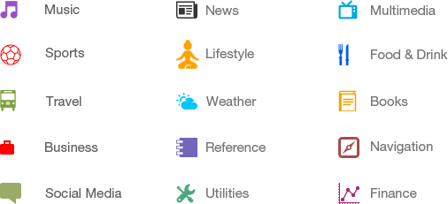
Categories of Android applications
Topic objective: This aims at various categories and need of android applications
Source: https://www.tutorialspoint.com/android/android_overview.htm

Slide 30
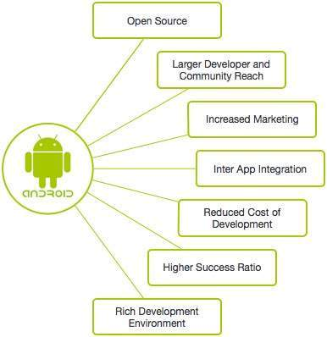
Need of Android
Source: https://www.tutorialspoint.com/android/android_overview.htm
Notes:
What is inter app integration?
Android supports Inter-Application Integration in which two different software can connect. This makes the Android platform attractive for handset manufacturers & wireless operators, resulting in faster development of Android-based phones.

Slide 31
Features of Android
Topic objective: To understand about the useful features of android
Sr.No. | Feature & Description
1 | Beautiful UI Android OS basic screen provides a beautiful and intuitive user interface.
2 | Connectivity GSM/EDGE, IDEN, CDMA, EV-DO, UMTS, Bluetooth, Wi-Fi, LTE, NFC and WiMAX.
3 | Storage SQLite, a lightweight relational database, is used for data storage purposes.
4 | Media support H.263, H.264, MPEG-4 SP, AMR, AMR-WB, AAC, HE-AAC, AAC 5.1, MP3, MIDI, Ogg Vorbis, WAV, JPEG, PNG, GIF, and BMP.
5 | Messaging SMS and MMS
6 | Web browser Based on the open-source WebKit layout engine, coupled with Chrome's V8 JavaScript engine supporting HTML5 and CSS3.
7 | Multi-touch Android has native support for multi-touch which was initially made available in handsets such as the HTC Hero.

Slide 32
Features of Android
Sr.No. | Feature & Description
8 | Multi-tasking User can jump from one task to another and same time various application can run simultaneously.
9 | Resizable widgets Widgets are resizable, so users can expand them to show more content or shrink them to save space.
10 | Multi-Language Supports single direction and bi-directional text.
11 | GCM Google Cloud Messaging (GCM) is a service that lets developers send short message data to their users on Android devices, without needing a proprietary sync solution.
12 | Wi-Fi Direct A technology that lets apps discover and pair directly, over a high-bandwidth peer-to-peer connection.
13 | Android Beam A popular NFC-based technology that lets users instantly share, just by touching two NFC-enabled phones together.
Notes:
Android Beam is a discontinued feature of the Android mobile operating system that allowed data to be transferred via near field communication
(NFC). It allowed the rapid short-range exchange of web bookmarks, contact info, directions, YouTube videos, and other data. When phone touches other phone

Slide 33
DAILY QUIZ 2
1. For which of the following Android is mainly developed?
Servers
Desktops
Laptops
Mobile devices
2. Android User, Developer, Equipment Maker are …….of the android ecosystem.
3. Which of the following is the first mobile phone released that ran the Android OS?
HTC Hero
Google gPhone
T - Mobile G1
None of the above
4. Full form of GCM
Notes:
Gcm google cloud messgaing to firebase cloud messaging

Slide 34
The Android Market
Topic objective: To understand about the android market and platform
In August 2008, Google announced Android Market, an online application store for Android devices.
Using this app that is preinstalled on their Android device, users can simply download third-party applications.
Both paid and free applications are supported on the Android Market.
This app is currently known as Google Playstore

Slide 35
The Android Platform
The Android platform is a platform for mobile devices that uses a modified Linux kernel.
The Android Platform was introduced by the Open Handset Alliance in November of 2007.
Most applications that run on the Android platform are written in the Java programming language.
To create an application for the platform, a developer requires the Android SDK, which includes tools and APIs.
To shorten development time, Android developers typically integrate the SDK into graphical user IDEs (Integrated Development Environment)

Slide 36
Establishing the development environment
Topic objective: To install and use IDE
1. One can start your Android application development on either of the following operating systems −
Microsoft Windows XP or later version.
Mac OS X 10.5.8 or later version with Intel chip.
Linux including GNU C Library 2.7 or later.
2. list of software's you will need before you start your Android application programming.
Java JDK5 or later version
Android Studio
3. Set-up Java Development Kit (JDK)
4. Android IDEs
Android Studio
Eclipse IDE(Deprecated)

Slide 37
Android SDK
Android SDK stands for Android Software Development Kit which is developed by Google for Android Platform.
With the help of Android SDK, we can create android Apps easily.
Android SDK is a collection of libraries and Software Development tools that are essential for Developing Android Applications.
Whenever Google releases a new version or update of Android Software, a corresponding SDK also releases with it.
In the updated or new version of SDK, some more features are included which are not present in the previous version.
Android SDK consists of some tools which are very essential for the development of Android Application.
These tools provide a smooth flow of the development process from developing and debugging.
Android SDK is compatible with all operating systems such as Windows, Linux, macOS, etc

Slide 38
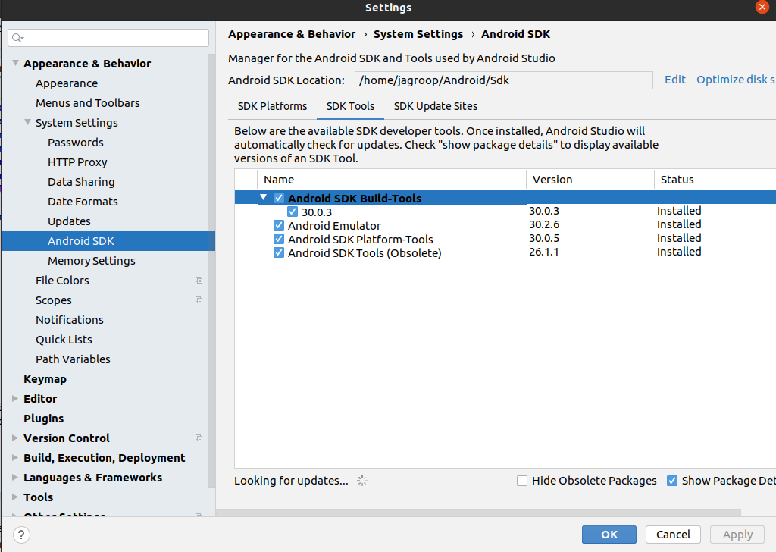
Android SDK

Slide 39
DAILY QUIZ 3
Name the educational apps on google playstore.
Full form of SDK.
Android is based on which language. (JAVA/Python/DotNet)
Is Android SDK is compatible with all operating systems such as Windows, Linux, macOS, etc

Slide 40
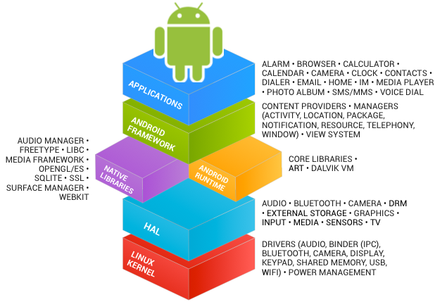
Components of Android SDK
Topic objective: To understand the SDK tools and components of android
1. Android SDK Tools
Android SDK tool is an important component of Android SDK. It consists of a complete set of development and debugging tools.
Below are the SDK developer tools:
Android SDK Build tool.
Android Emulator.
Android SDK Platform-tools.
Android SDK Tools.

Slide 41
Components of Android SDK
2. Android SDK Build-Tools
Android SDK build tools are used for building actual binaries of Android App.
The main functions of Android SDK Build tools are built, debug, run and test Android applications.
The latest version of the Android SDK Build tool is 30.0.3.
While downloading or updating Android in our System, one must ensure that its latest version is download in SDK Components.

Slide 42
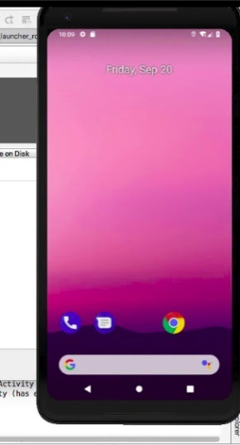
Components of Android SDK
3. Android Emulator
An Android Emulator is a device that simulates an Android device on your system. Suppose we want to run our android application that we code.
1. Android Mobile by Enabling USB Debugging on our mobile.
2. Android Emulator.
In Android Emulator the virtual android device is shown on our system on which we run the Android application that we code.
Thus, it simply means that without needing any physical device Android SDK component “Android Emulator” provides a virtual device on the System where we run our Application. The emulator’s come with the configuration for Various android phones, tablets, Wear OS, and Android TV devices.

Slide 43
Components of Android SDK
In Android Virtual Emulator all functions that are feasible on real Android mobile is works on virtual Device like:
phone calls, text messages.
stimulate different network speeds.
specify the location of a device
access on google play store and lot’s more.
But there is one disadvantage of this emulator is that it is very slow when System’s PC has less RAM.
It works fine when a maximum GB of RAM is present on our device.

Slide 44
Components of Android SDK
4. Android SDK Platform-tools
Android SDK Platform-tools is helpful when we are working on Project and they will show the error messages at the same time. It is specifically used for testing.
It includes:
Android Debug Bridge (ADB), is a command-line tool that helps to communicate with the device.
It allows us to perform an action such as Installing App and Debugging App etc.
Fastboot allows you to flash a device with a new system image.
Systrace tools help to collect and inspect timing information. It is very crucial for App Debugging.

Slide 45
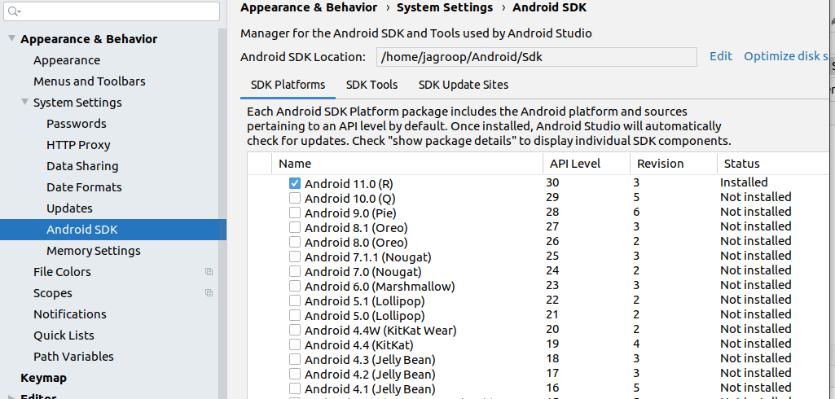
Components of Android SDK
5. Android SDK Tools
Android SDK tool is a component of SDK tool. It consists of a set of tools which and other Utilities which are crucial for the development of Android Application. It contains the complete set of Debugging and Development tools for android.
6. SDK Platforms
For Each Android Software, one SDK platform is available as shown below:

Slide 46
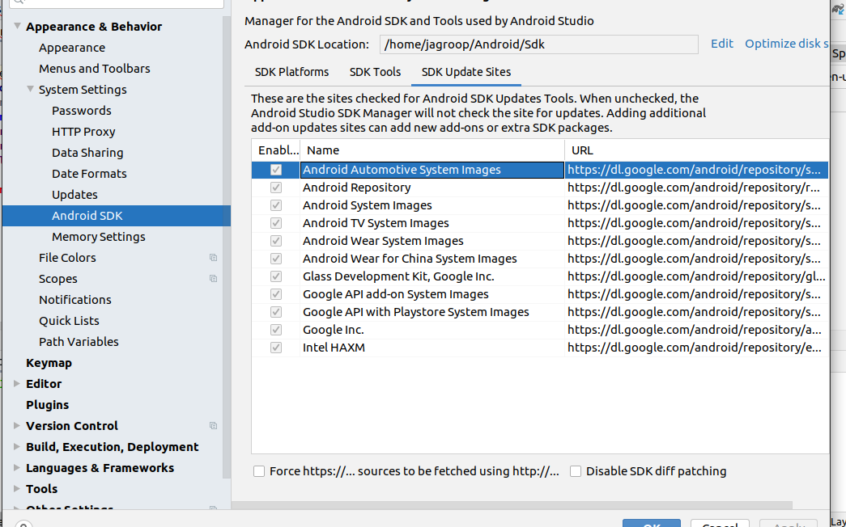
Components of Android SDK
7. SDK Update Sites
In SDK Update Sites, some sites are embedded in it which will check for Android SDK Updates Tools. In this, one must ensure we don’t unclick the button below because these are checked by default which will check for updates if we will unclick it then it doesn’t check updates for those.

Slide 47
DAILY QUIZ 4
An APK is a short form of the Android Package Kit. An APK file is the file format used to install the applications on the android operating system. (T/F)
What is an activity in android?
android class
android package
A single screen in an application with supporting java code
None of the above
3. ADB stands for
Android Debug Bridge.
Android Drive Bridge.
Android Delete Bridge
Android Destroy Bridge.

Slide 48
Android Applications
Topic objective: To understand about the applications and installation of android
Android applications are usually developed in the Java language using the Android Software Development Kit.
Once developed, Android applications can be packaged easily and sold out either through a store such as Google Play, SlideME, Opera Mobile Store, Mobango, F-droid and the Amazon Appstore.
Android powers hundreds of millions of mobile devices in more than 190 countries around the world.
It's the largest installed base of any mobile platform and growing fast.
Every day more than 1 million new Android devices are activated worldwide.

Slide 49
Android Installation
To install Android Studio on Windows, proceed as follows:
If you downloaded an .exe file (recommended), double-click to launch it.
If you downloaded a .zip file, unpack the ZIP,
copy the android-studio folder into your Program Files folder, and then open the android-studio > bin folder and launch studio64.exe (for 64-bit machines) or studio.exe (for 32-bit machines).
Follow the setup wizard in Android Studio and install any SDK packages that it recommends.

Slide 50
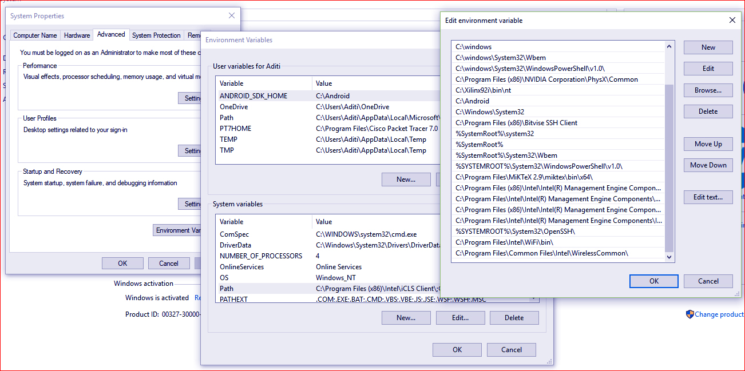
Set-up android stdio
There are just three steps for installing Android studio for windows which are as follows:
Firstly, to download Android Studio click on the link given below, https://developer.android.com/studio/?gclid=CjwKCAiA4t_iBRApEiwAn-vt-76uWkKeOmcrZxTYZ-got8ljyDlBQS28wg8w9S4kLUmbHKn4Wb0DwBoCzm8QAvD_BwE
This will direct you to the official website of Android Studio.

Slide 51
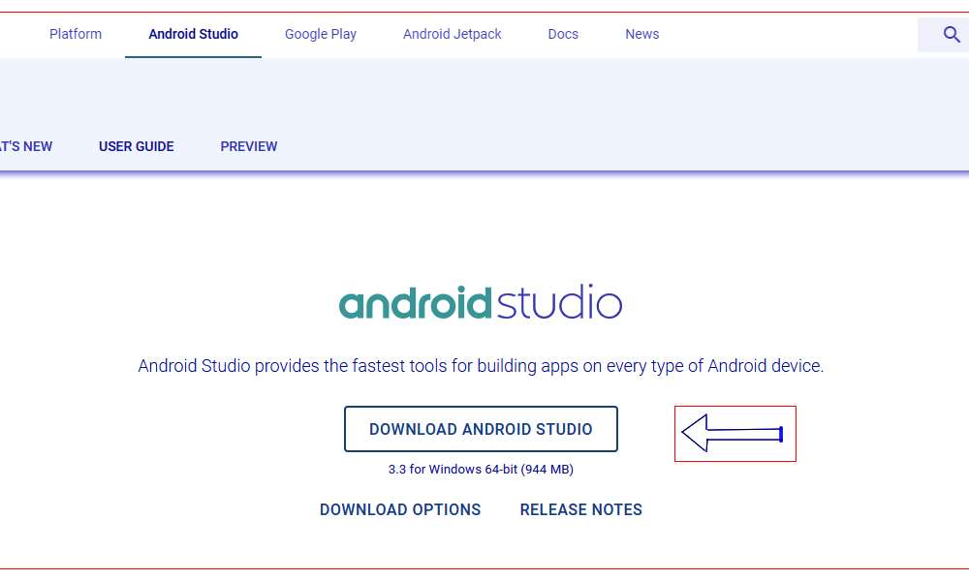
Set-up android stdio
2. Then, click on download Android Studio as shown.

Slide 52
Set-up android stdio
3. Lastly, click on the downloaded file and packages will install, automatically.
We are done with installation for windows and now you can start making your application using Android Studio.

Slide 53
DAILY QUIZ 5
Name the latest version of Android.
2. Among the below virtual machines choose the one which is used by the Android operating system
JVM
Simple virtual machine
Dalvik operating system
None
3. Which of the following is not a Features of Android?
A. Connectivity B. Storage C. Slide Mobango D. Multi-touch

Slide 54
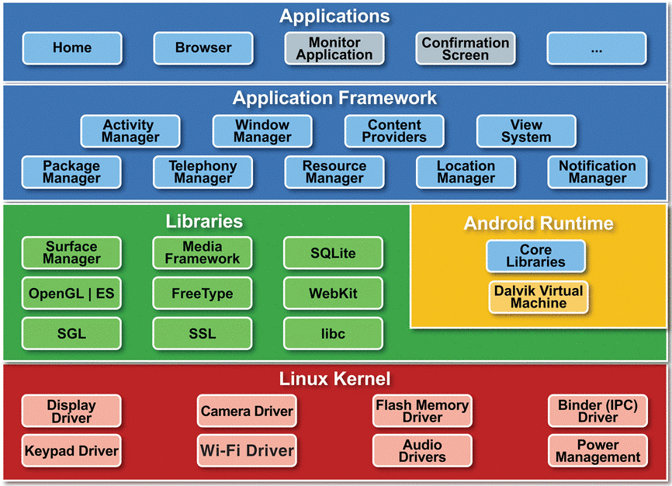
Architecture of Android
Topic objective: To understand about the architecture of android and how it affects the internal structure

Slide 55
Architecture of Android
The Android OS is roughly divided into five sections in four main layers:
Linux kernel —
This is the kernel on which Android is based.
Provides core services
Security
Memory management.
Process management.
File and network I/O
Device drivers.
Android specific services
Power management
Memory sharing
Low memory killer
IPC - Binder
Libraries —
Native Libraries written in C and C++.
System C Library Surface manager
Media framework WebKit ( Web browser)
OpenGL (Graphics engine) SQLite ( In-memory databases)

Slide 56
Android runtime
At the same layer as the libraries, the Android runtime provides:
A set of core libraries that enable developers to write Android apps using the Java programming language (java.*, javax.*, android.*, org.*, junit.*).
Dalvik virtual machine.
Dalvik is a specialized virtual machine designed specifically for Android.
WorkFlow –
Applications are written in java.
Compiled to java bytecodes.
DX converts (compiles) java bytecodes to a single DEX bytecode file (Dalvik executables).
DVM executes DEX bytecode file.
DVM enables every Android application to run in its own process, with its own instance of the Dalvik virtual machine.
It is optimized for battery-powered mobile devices with limited memory and CPU.

Slide 57
Architecture of Android
Application Framework
Exposes the various capabilities of the Android OS to application developers so that they can make use of them in their applications.
Package Manager - keeps track of all apps currently installed on phone.
Window Manager – manages windows and sub windows.
View System – Buttons, Icons, etc.
Resource Manager – manages the non-compiled resources of an app.
E.g. Strings (eg. support for different languages), Layout files.
Activity Manager – supports navigation between many activities of an app.
Content Provider – they are databases that allow apps to store and share data, developed to work across applications.
Eg: Contacts.
Location Manager – allows apps to receive location and movement information (GPS) to do context specific tasks.
Notification Manager – allows apps to place information in the notification bar.

Slide 58
Architecture of Android
Applications
At this top layer, we will find applications that are built in with the Android device (such as Phone, Contacts, Browser, etc.), as well as applications that we download and install from the Android Market.
None of these apps are hardcoded into the system.

Slide 59

Selecting Protocols For Android
To select your protocol:
On your main screen, tap the WiFi Security app icon
In the upper right corner of the screen, tap the Settings icon.
Tap Protocols
Select any of the following protocol radio buttons:
Automatic – Connects to the best protocol among the ones listed below. Can fall back to other protocols.
OpenVPN – OpenVPN is the recommended protocol of choice. Highest performance for maximum security and speed.
IKEv2 – Internet Key Exchange version 2. This is faster and more secure than L2TP, and is considered to be a very reliable and stable VPN protocol.

Slide 60
REQUIRED TOOLS
Topic objective: To know about the tools required for android
Android development can be done on a Mac, a Windows PC, or a Linux machine.
Android makes use of the Java SE Development Kit (JDK). Hence the development system should have JDK installed.
The most important piece of software we need to download is the Android SDK.
It contains a debugger, libraries, an emulator, documentation, sample code, and tutorials.
It can be download from http://developer.android.com/sdk/index.html

Slide 61
SDK Tools
The tools can be generally categorized into two types.
SDK tools
Platform tools
Sr.No | Tool & description
1 | Android: This tool lets you manage AVDs, projects, and the installed components of the SDK
2 | Ddms: This tool lets you debug Android applications
3 | Draw 9-Patch: This tool allows you to easily create a NinePatch graphic using a WYSIWYG editor
4 | Emulator: This tools let you test your applications without using a physical device
5 | Mksdcard: Helps you create a disk image (external sdcard storage) that you can use with the emulator
6 | Proguard: Shrinks, optimizes, and obfuscates your code by removing unused code
7 | Sqlite3: Lets you access the SQLite data files created and used by Android applications
8 | Traceview: Provides a graphical viewer for execution logs saved by your application
9 | Adb: Android Debug Bridge (adb) is a versatile command line tool that lets you communicate with an emulator instance or connected Android-powered device.
https://www.tutorialspoint.com/android/android_developer_tools.htm

Slide 62
DAILY QUIZ 6
1. Which of the following method in android is used to log debug messages?
Log.r()
Log.R()
Log.d()
Log.D()
2. Bottom layer is known as?
Libraries
Linux kernel
Application Framework
Applications
3. Which of the following converts Java byte code into Dalvik byte code?
Dalvik converter
Dex compiler
Mobile interpretive compiler (MIC)
None of the above

Slide 63
Android Basic Building Blocks
Topic objective: To know about the basic building blocks required for android
App components
App components are the essential building blocks of an Android app.
Each component is an entry point through which the system or a user can enter your app. Some components depend on others.
There are four different types of app components:
Activities
Services
Broadcast receivers
Content providers

Slide 64
Android Basic Building Blocks
Activities
An activity is the entry point for interacting with the user. It represents a single screen with a user interface.
For example, an email app might have one activity that shows a list of new emails, another activity to compose an email, and another activity for reading emails.
Although the activities work together to form a cohesive user experience in the email app, each one is independent of the others.

Slide 65
Android Basic Building Blocks
An activity facilitates the following key interactions between system and app:
Keeping track of what the user currently cares about (what is on screen) to ensure that the system keeps running the process that is hosting the activity.
Knowing that previously used processes contain things the user may return to (stopped activities), and thus more highly prioritize keeping those processes around.
Helping the app handle having its process killed so the user can return to activities with their previous state restored.
Providing a way for apps to implement user flows between each other, and for the system to coordinate these flows. (The most classic example here being share.)
You implement an activity as a subclass of the Activity class. For more information about the Activity class, see the Activities developer guide.

Slide 66
Android Basic Building Blocks
Services
A service is a general-purpose entry point for keeping an app running in the background for all kinds of reasons. It is a component that runs in the background to perform long-running operations or to perform work for remote processes. A service does not provide a user interface. There are two types of services that tell the system how to manage an app: started services and bound services.
Broadcast receivers
A broadcast receiver is a component that enables the system to deliver events to the app outside of a regular user flow, allowing the app to respond to system-wide broadcast announcements. Because broadcast receivers are another well-defined entry into the app, the system can deliver broadcasts even to apps that aren't currently running.
So, for example, an app can schedule an alarm to post a notification to tell the user about an upcoming event... and by delivering that alarm to a BroadcastReceiver of the app, there is no need for the app to remain running until the alarm goes off.

Slide 67
Android Basic Building Blocks
Content providers
A content provider manages a shared set of app data that you can store in the file system, in a SQLite database, on the web, or on any other persistent storage location that your app can access. Through the content provider, other apps can query or modify the data if the content provider allows it.
For example, the Android system provides a content provider that manages the user's contact information. As such, any app with the proper permissions can query the content provider, such as ContactsContract.Data, to read and write information about a particular person.

Slide 68
DAILY QUIZ 7
1. Which of the following is not a state in the service lifecycle?
Destroyed
Start
Paused
Running
2. In which state the activity is, if it is not in focus, but still visible on the screen?
Stopped state
Destroyed state
Paused state
Running state
Activity Manager is used to?
Controls all aspects of the application lifecycle and activity stack.
Allows applications to publish and share data with other applications.
Provides access to non-code embedded resources such as strings, color settings and user interface layouts.
Allows applications to display alerts and notifications to the user.

Slide 69
WEEKLY ASSIGNMENT
Explain android and its history.
What is android? Explain their versions and applications?
Discuss about configuring the android SDK
Briefly discuss about ADT Tools
Discuss the needs and feature of android
Draw and discuss the android architecture.
Case study to know about your android phone architecture.
Discuss the various android platform tools and building blocks.
Explain android application framework.

Slide 70
TOPIC LINKS
https://www.tutorialspoint.com/android/android_developer_tools.htm
https://www.tutorialspoint.com/android/android_overview.htm
https://developer.android.com
https://developer.android.com/guide/components/fundamentals

Slide 71
MCQ
1. Identify the language on which Android is based upon.
JAVA
Python
C++
None
2. Which of the following virtual machine is used by the Android operating system?
JVM
Dalvik virtual machine
Simple virtual machine
None of the above

Slide 72
MCQ
3. The full form of APK is
Android page kit
Android phone kit
Android package kit
Android photo kit
4. Which of the following kernel is used in Android?
MAC
Windows
Linux
Redhat

Slide 73
MCQ
5. In android, mini activities are also known as
Adapter
Activity
Fragments
None
6. Does android support other languages than java?
Yes
No
May be
Can't say

Slide 74
MCQ
7. What is the use of content provider in Android?
For storing the data in the database
For sharing the data between applications
For sending the data from an application to another application
None of the above
8. Which of the following is the topmost layer of android architecture?
System Libraries and Android Runtime
Linux Kernel
Applications
Applications Framework

Slide 75
MCQ
9. Which of the following is contained in the src folder?
XML
Java source code
Manifest
None of the above
10. In which year OHA (Open Handset Alliance) is announced?
2005
2007
2006
None of the above

Slide 76
Glossary Questions
Explain the following:
SDK
API
SDE
Adb
OpenGl
GNU
Emulator
Dalvik virtual machine
Mksdcard
SQLite

Slide 77
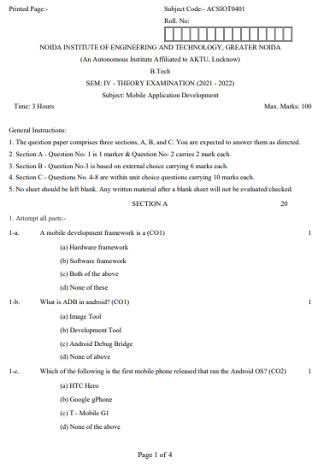
Old University Exam Question Paper

Slide 78
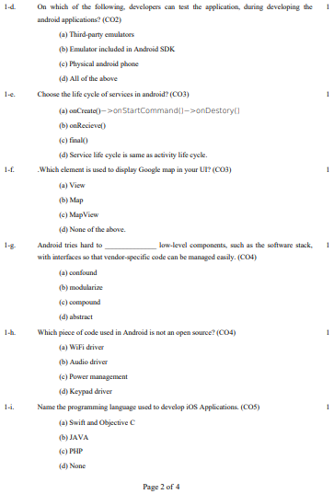
Old University Exam Question Paper

Slide 79
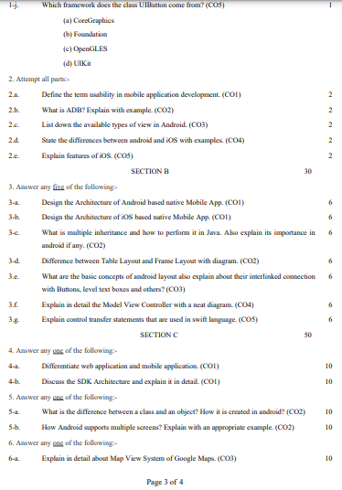
Old University Exam Question Paper

Slide 80
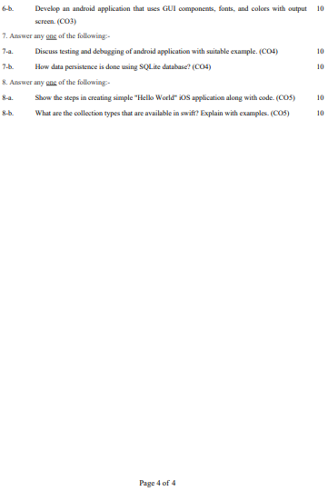
Old University Exam Question Paper

Slide 81
Expected Questions
Explain the type of user Interfaces in mobile application.
Elaborate Android Architecture and its Applications?
Discuss Applications hosted in the cloud computing environment?
Discuss android ecosystem and its usefulness.
How to build android application.
Discuss various tools required to develop android.
Explain the various versions of android.
Explain Activities, Services, Broadcast Receivers & Content providers.
Discuss need and features of android.
Comment on the android platforms.

Slide 82
Recap/Summary
Discussed the key concepts of android
Elaborated the features and android platform
Discussed the android SDK and architecture
Understood the installation of Android and using the basics
Know about the Activities, Services, Broadcast Receivers & Content providers.

Slide 83
Noida Institute of Engineering and Technology, Greater Noida
THANK YOU !!

